Slide 1
Project C.A.S.P.
Week 11, 4/17/17
Ryan Tedeschi
Dylan Carson

Slide 2
Weekly Progress
Translate Module Completed
Both Core & Standalone Implementations
Print Module added to Standalone Application
Cleanup
Parse Tree issues fixed
i.e. Where it recognized terminals, but failed to recognize the containing productions
Analyze module
Needs extra logic to complete
Need to keep track of variable values in order to determine if a loop is constant or not

Slide 3
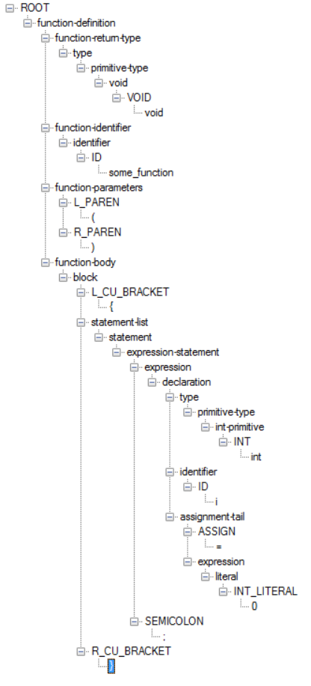

Print Module: Standalone Implementation
Generated From the following code
Simply prints out the parse tree in an easily navigable form
Features collapsible nodes to more easily focus on a particular subtree

Slide 4
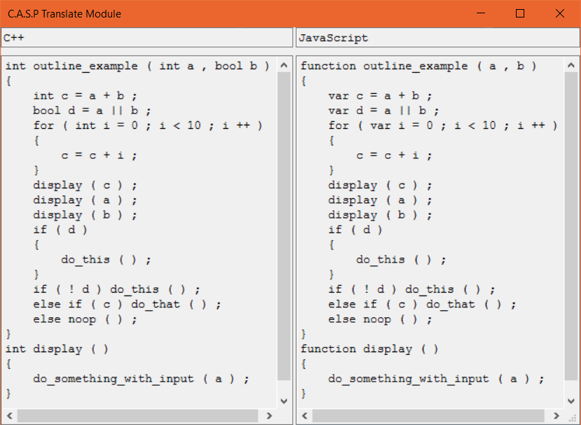
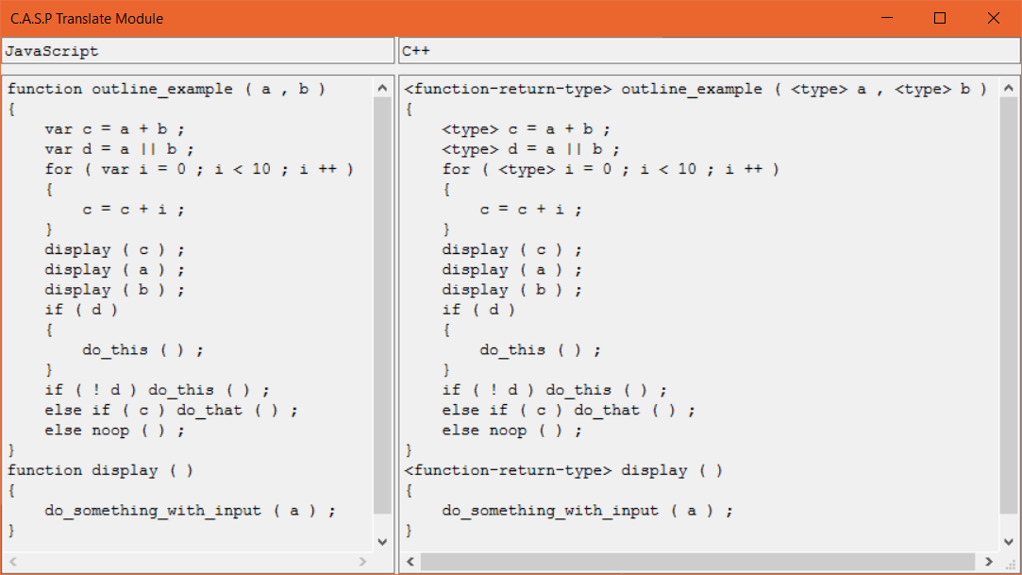
Translate Module: Visual Example
More to Less specific, good translation
Less to More specific, failed translation

Slide 5
Weekly Tasks
Collective Tasks
Complete Analyze Module
Create table of variables declared and assigned
Cleanup
Error Handling
Documentation

